Slide 1
Annual Interagency Accessibility Forum
Unlocking the Power of Accessibility
October 11-13, 2022
Mission Accessible – Getting the Job Done
Angela Watkins (PBGC)
Notes:
Bio read by Moderator
Angela Watkins Short Bio
Angela Watkins, a certified Project Manager and CGEIT certified professional, has served as the Section 508 Program Manager for Pension Benefit Guaranty Corporation since January 2018. She’s been aware of the goals of accessibility since serving on agency wide team in 2001. Prior to her current role, she’s had experience as a Business Representative, Service Desk Manager, Procurement Support, and a Contracting Officer Representative ensuring that products and deliverables she was responsible for included Section 508 compliance as a requirement. She serves as the chair of the Section 508 Intra-Agency team comprised of representatives from the agency’s communications, human resources, legal, EEO, IT, facilities and procurement departments. She and her team have been effective in promoting the message that “Accessibility is Everyone’s Responsibility” in her agency.

Slide 2
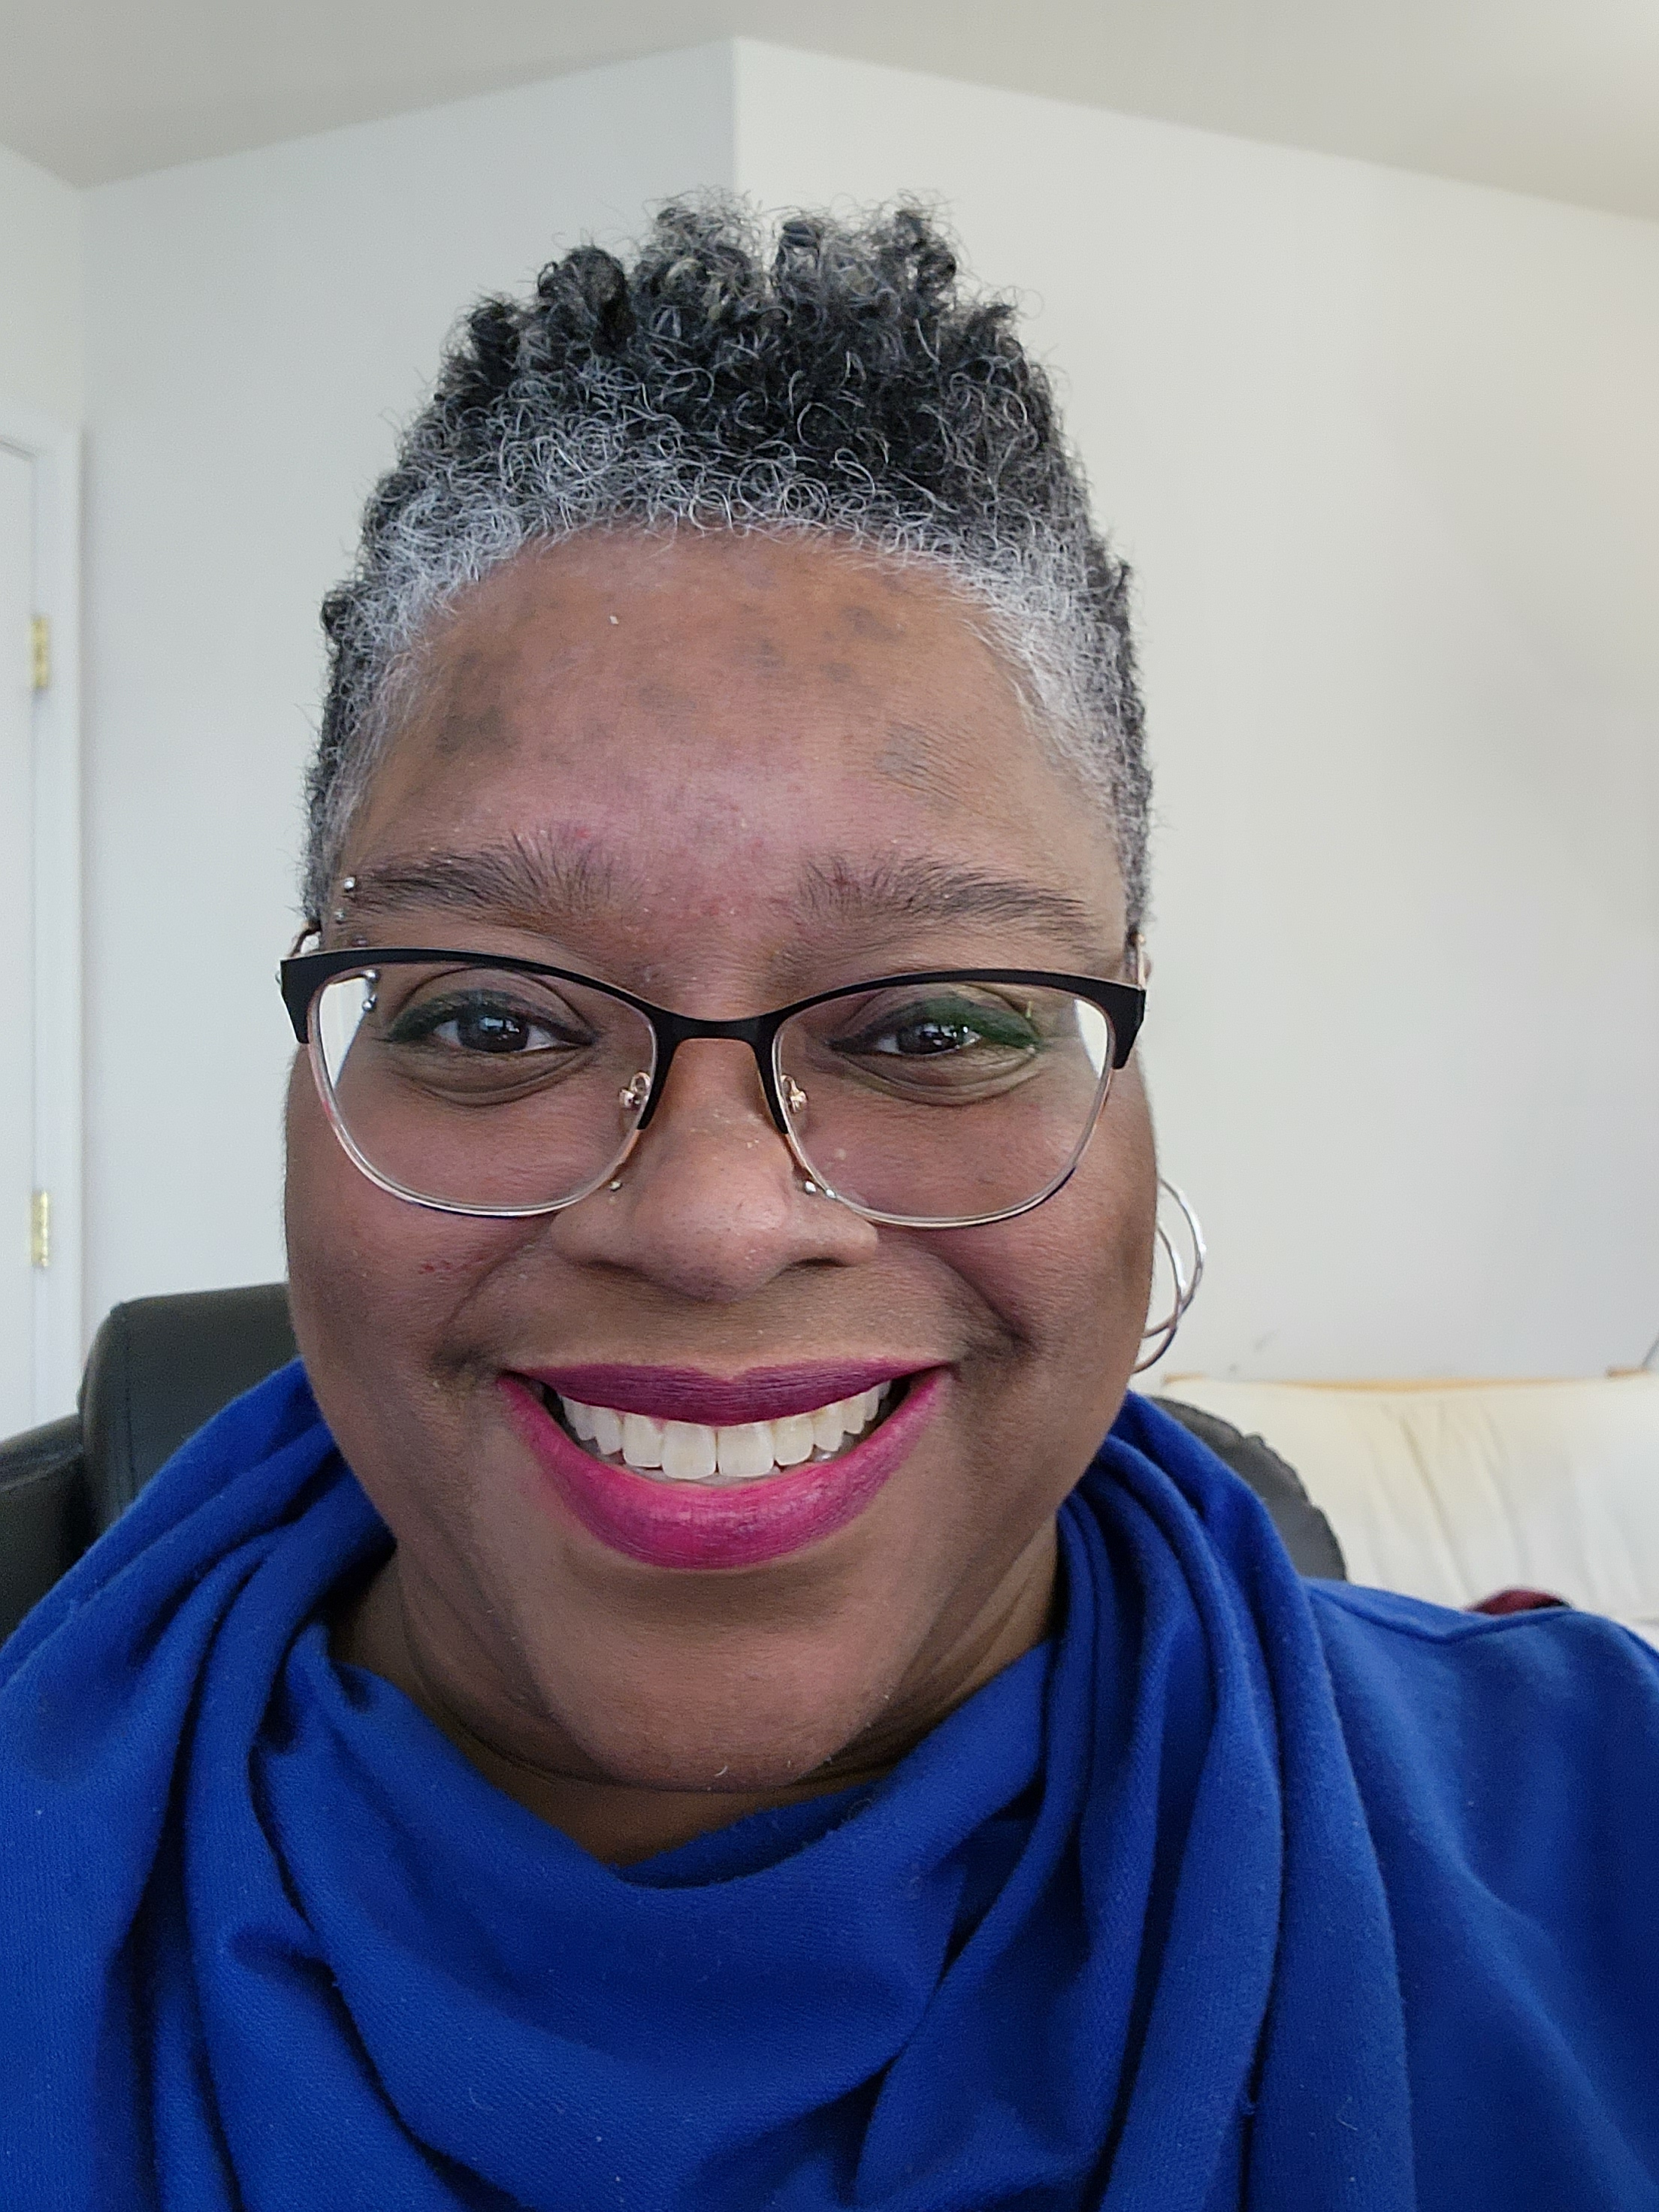
Angela Watkins, Section 508 Program Manager
Pension Benefit Guaranty Corporation (PBGC)
Office of Information Technology
Enterprise Governance Department, Policy Compliance Division
445 12th Street SW
Washington DC 20024
(202) 229-3181
Section 508 Program Manager
Angela Watkins email: watkins.angela@pbgc.gov
My job is to— Share what I know with others, and Learn from those who want to share with me (–arw)
Notes:
Speaker: Angela
Angela Watkins serves as the Section 508 Program Manager. She’s been in the position since 2018 as noted before and been involved with accessibility since 2001.

Slide 3
Mission Accessible – How it started – in 2020
In honor of Accessibility Awareness, specifically Disability Employment Awareness month, Section 508 is showcasing: Mission Accessible: Getting the Job Done
Offered a way to supported the Empathy Focused Section 508 Q&A Session Topic of the Month and the Empathy Leads to Action Poem included
Notes:
First Showcased 10/26 -10/30/2020
Supports the action of the last stanza of the poem shared during10/20/2020 Great Debate Q&A Session
Sympathy is a reaction - Empathy Leads to Action
Why should I care how you fare
when you use IT
that you can't see
As you look on in fear
at yet another video about to play that you can't hear
Why should I care how you fare
as your eyes glaze and your head you bend
at another email your brain can't immediately comprehend
they pulled out a lot of big words from the dictionary
forgetting to speak the language of those of us who are special in our ordinary
Why should I care how you fare
that you can't move a mouse like they say you might
and there's no keyboard option or voice command available to solve your plight
What I need from you is to pay attention and apply the rules of accessibility
that's the best and most important thing you can ever do for me
It's not even about a sense of misplaced sympathy
It's about using a bit of time, effort and some effective empathy
If you took a moment to walk in even one shoe
You'd realize what's needed is not that hard to do
So I'm able to showcase my greatness and work productively
and enjoy all that - just like you - while doing it independently
~ Angela R. Watkins 11/2019

Slide 4
Mission Accessible – The email that was sent
Each day you’ll receive an email from the Section 508 Compliance mailbox with the details of your mission.
That email will self-destruct within 24 hours of delivery.
Okay, technically, it will just expire.
The subject line will appear with a line going through it.
Notes:
We’re going to review the missions and the campaigns and

Slide 5
Mission Accessible – the email continued
Your mission, should you choose to accept it, must be completed on that day and that day only.
Once you’re done, use the link in the email to report out.
We will avow your status and applaud your efforts to complete your mission.
Feel free to contact us if you need us.
Good Luck

Slide 6

Mission Accessible – Literally one mission per day
Mission Accessible 1 available Monday
Mission Accessible 2 available Tuesday
Mission Accessible 3 available Wednesday
Mission Accessible 4 available Thursday
Mission Accessible 5 available Friday

Slide 7
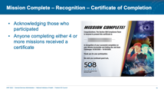
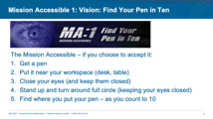
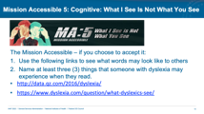
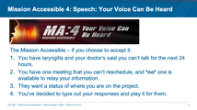
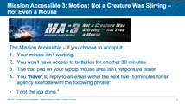
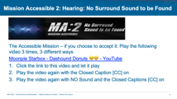
Mission Accessible Summary Slide
Notes:
Note: In Presentation Mode – clicking the slide images jumps to a specific section. Beneficial for Q&A and to go to a specific topic immediately.

Slide 8

Mission Accessible 1: Vision: Find Your Pen in Ten
The Mission Accessible – if you choose to accept it:
Get a pen
Put it near your workspace (desk, table)
Close your eyes (and keep them closed)
Stand up and turn around full circle (keeping your eyes closed)
Find where you put your pen – as you count to 10

Slide 9

Mission Accessible 2: Hearing: No Surround Sound to be Found
The Accessible Mission – if you choose to accept it: Play the following video 3 times, 3 different ways
Moonpie Starbox - Dashound Donuts 😆😃 - YouTube
Click the link to this video and let it play
Play the video again with the Closed Caption [CC] on
Play the video again with NO Sound and the Closed Captions [CC] on

Slide 10

Mission Accessible 3: Motion: Not a Creature Was Stirring – Not Even a Mouse
The Mission Accessible – if you choose to accept it:
Your mouse isn’t working.
You won’t have access to batteries for another 30 minutes.
The trac pad on your laptop mouse area isn’t responsive either
You *have* to reply to an email within the next five (5) minutes for an agency exercise with the following phrase:
“I got the job done.”

Slide 11
Mission Accessible 3: Motion: Hints for Outlook email Navigation
Hitting the ALT key displays keyboard short cut options
Select the letter and letter combinations to get to the menu option
Use your arrows to navigate along menu options
Tab helps move from one area to the next
Shift + Tab helps navigate backwards

Slide 12

Mission Accessible 4: Speech: Your Voice Can Be Heard
The Mission Accessible – if you choose to accept it:
You have laryngitis and your doctor’s said you can’t talk for the next 24 hours.
You have one meeting that you can’t reschedule, and *no* one is available to relay your information.
They want a status of where you are on the project.
You’ve decided to type out your responses and play it for them.

Slide 13
Mission Accessible 4: Speech: Practice
You’re going to practice so you’re ready before the actual call.
Open Microsoft Word
Type the following text:
“I promised it by next week, and you’ll have it next week as scheduled.”
Go to the Review Menu
Select the text that was typed
Select Read Aloud
Note: You can use the gear icon to change the voices and speed
Notes:
https://www.section508.gov/tools/playbooks/technology-accessibility-playbook-intro/
Catching People in person vs Virtual options
Being more strategic and deliberate – less chance for accidental meetings

Slide 14

Mission Accessible 5: Cognitive: What I See Is Not What You See
The Mission Accessible – if you choose to accept it:
Use the following links to see what words may look like to others
Name at least three (3) things that someone with dyslexia may experience when they read.
http://data.qz.com/2016/dyslexia/
https://www.dyslexia.com/question/what-dyslexics-see/

Slide 15
Mission Accessible 5: Cognitive: Bonus Mission
And, if you’re feeling especially mission focused – how would you fix some of the formatting and text displayed in the sample text area:
Sample text with bad formatting that makes reading more difficult.
Sometimes the lettres get a bit confused
It’s not like it’s anything type of news
As good as the grimmer checker can be
What I dear and what you see is not the same to me

Slide 16
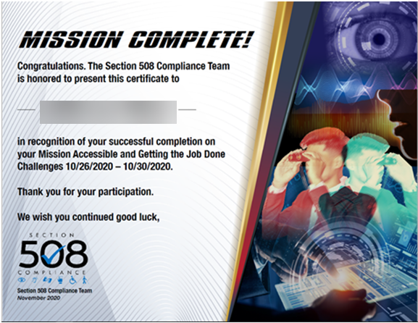
Mission Complete – Recognition – Certificate of Completion
Acknowledging those who participated
Anyone completing either 4 or more missions received a certificate
Notes:
This is a recap of the items already discussed. This will be the next slide after the Zoom Summary Slide for the last Advocacy.

Slide 17
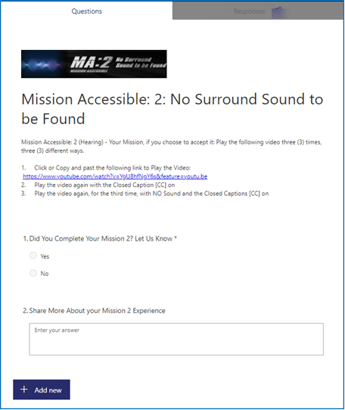
Mission Accessible: How Participation Was Tracked
There was a form for those who wanted to share their status
Captured their name & email
Included Mission Details
Asked if they completed the mission (required)
Share about their experience (optional)
Access expired by midnight each day

Slide 18
Mission Accessible: Reporting Out
Use of the Form
Via email – after the form option was so no longer available
We chose to avow their missions and keep count
Some completed the mission and didn’t report out at all

Slide 19
Your Mission… should you choose to accept it
Which Mission Would You Like to Complete?
On your own, or as a Group
Mission #1: Find Your Pen in Ten
Mission #2: No Surround Sound to be Found
Notes:
Your Mission… should you choose to accept it and if we have time for it ☺
Quickest Missions are either #1 or #2 and relatively easy to do
Mission #2 relies on YouTube – good internet connection; bypass ads.
Video includes opened caption; we’re reviewing closed captions
Moonpie Starbox - Dashound Donuts 😆😃 - YouTube

Slide 20
Questions?

